Slide 1
“Customer Segmentation And Spending Analysis – Insights Report”
~Aliya Rasheed

Slide 2
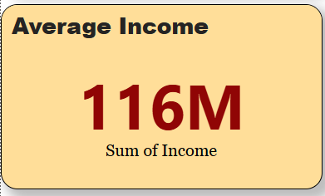
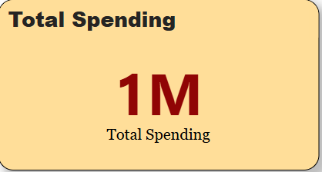
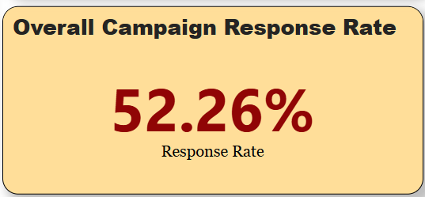
Overall KPIs
“Customer base shows high income but relatively lower spending. Campaign response is moderate (52.26%).”

Slide 3
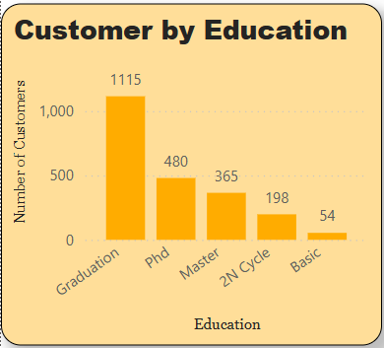
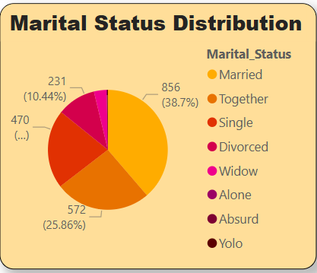
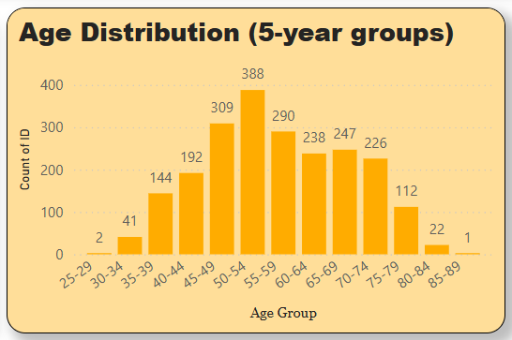
Customer Demographics
“Most Customers are graduate, majority are married, largest age group 30-40 years.”

Slide 4
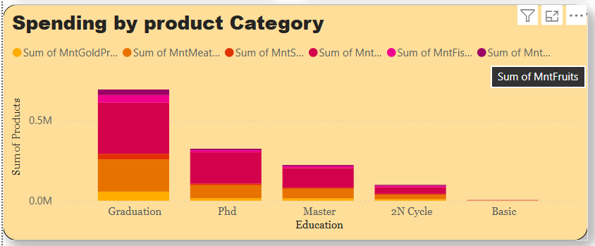
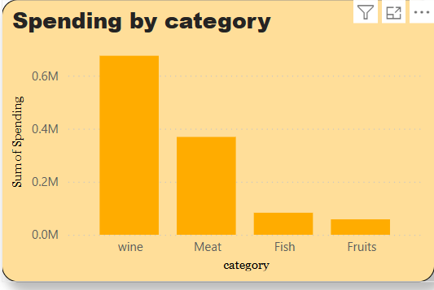
Spending Behavior
“Graduation related spending dominates, indicating education is the key driver.”

Slide 5
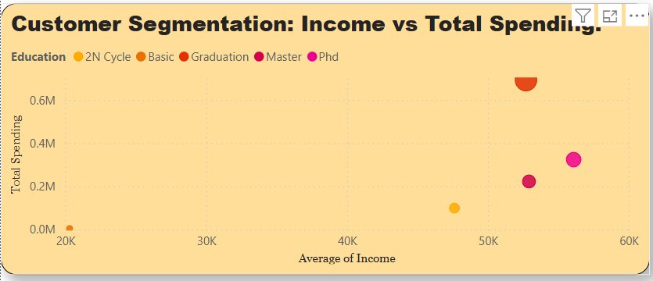
Income vs Spending Relationship
“Middle income groups spends more on average, while high income groups proportionally less.”

Slide 6
Summary and Recommendations
Focus marketing on graduates and 30-40 year old group.
Tailor products for middle income segment (they are more responsive).
Improve campaign strategies to fill response beyond 52%.

Slide 7
Thank you

